Slide 1
The study of DCNN method applicability to reduce routine work of a CFD-engineer
Presentation of the Final project on the SkillFactory course in Data Science
Cheremisov Stanislav
2022/01/28
Notes:
Zdravstvuite, menya zovut Cheremisov Stanislav. Ya inzhener po specialnosti samoleto I vertoleto stroenie,
na dannye moment rabotayu v komande vychislitelnoi gidro gazo dinami otdela perspektivnyh razrabotok yaponskoi korporacii Nabtesco.
Tema moego diplomnogo proekta zvuchit kak Исследование применимости метода Glubokih konvalyucionnyh neironnyh setei для сокращения рутинной работы инженера po gidro gazo dinamicheskim rasschetam.
(Pered tem kak nachat, hochu srazu izvinitsya za angliiskii yazyk na slaidah, pered temi dlya kogo eto ne sovsem komfortno. Svyazano eto s tem, chto mne tak zhe neobhodimo sdelat etot zhe doklad u sebya na rabote)

Slide 2

Agenda
Motivation
Machine learning for CFD application
Purpose
Concept and Workflow
Results and Discussion
Summary
Notes:
Moi segodnishnii doklad budet vyglyadit sleduyuschim obrazom
Vnachale ya raskazhu o motivacii vsego proekta
Provedu kratkii obzor vozmozhnyh napravlenii primeneniya Machine learning v sfere vyshislitelnoi gidro gazo dinamiki.
Oboznachu celi dannoi raboty
Vkratce raskazhu o hode raboty
I v konce rasskazhu o poluchennyh rezultatah

Slide 3
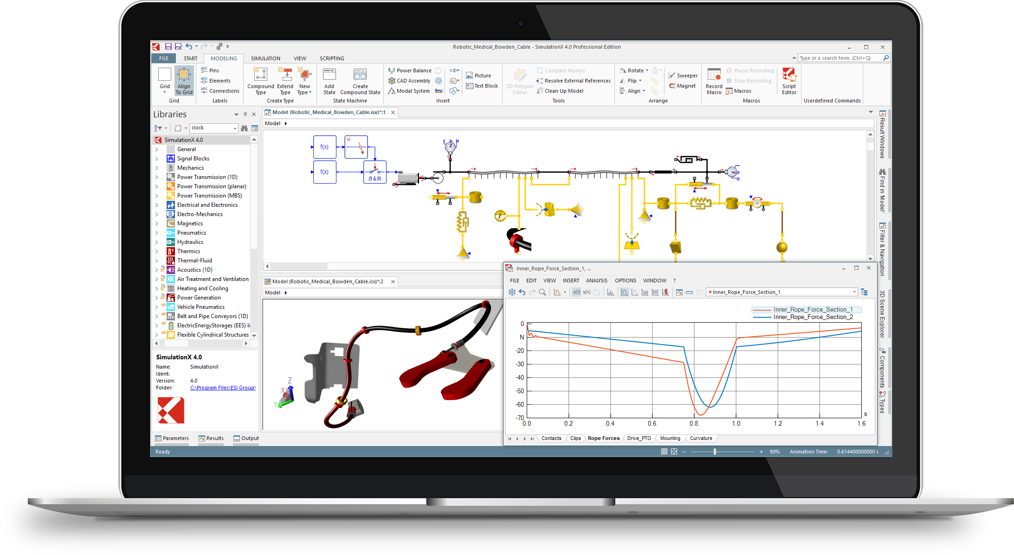
Motivation
The need to reduce the time to perform relatively simple, but at the same time frequently occurring Computational Fluid Dynamics (CFD) analysis on various types of pipelines, hydraulics systems etc.
Most popular 1D CAE:
SimulationX
Simulink/Matlab
GT-SUITE
COMSOL Multipthysics
※CFD - Computational Fluid Dynamics; CAE – Computer-aided engineering
Notes:
Nachnem s Motivacii,
Вычислительная гидродинамика (CFD) дает инженерам возможность получить tochnoe/подробное описание свойств/parametrov потока жидкости v chastnosti, I parametrov kakoi-libo sistemy v celom, eshe na etape proektirovaniya do izgotovleniya prototipa v zheleze.
V svoe vremya eto pozvolilo suchestvenno sokratit rashody na ispytaniya i sokratit samo vremya proektirovaniya produkta.
Odnako s uslozhneniem system stanovitsya slozhnee podbirat parametry razrabatyvaemoi sistemy, iz-za chego na podpor vsego odnogo parametra mozhet potrebovatsya ot neskolkih desyatkov do neskolki soten CFD raschetov.
Odnako so stremleniem kompanii k uluchsheniyu harakteristik ee produktov I vyzvannym vsvyazi s etim rostom slozhnosti togo ili inogo produkta. Stalo slozhnee priderzhivatsya ustoyavsheisya praktike, kogda pri proektirovanii novogo produkta mozhno bylo osnovyvayas na opyte inzhenera I kakih to ne slozhnyh inzhenernyh raschetah, razrabotat prototip, kotoryi peredaetsya inzheneru raschetchiku dlya provedeniya vsestoronnih virtualnyh ispytanii.
Vse chasche stanovitsya neobhodimym uzhe na etape prototipirovaniya provodit seriyu iz neskolkih desyatkov ili dazhe soten CFD raschetov dlya podbora tolko odnogo parametra sistemy.
Chto ponyatno privodit k udorazniyu razrabotki, no I vyzyvaet “zatory” na vychislitelnyh serverah.
Dlya obhoda etoi problem na rynke programmnogo obespecheniya suschestvuyut, tak nazyvaemye, sistemy 1D CAE,
Kotorye s odnoi storony pozvolyayut sokratit vremya raschetov, no s drugoi - predyavlyayut vysokie trebovaniya k polzovotelyu.
Tak kak sostavlenie I nastroika takih modelei trebuyut glubokogo ponimaniya vseh proishodyaschihv sisteme processov.
Modeli 1D CAE sostoyat iz blokov, kazhdyi iz kotoryh pri pomoschi nabora analiticheskih uravnenii opisyavet kakuyuto sostavnuyu chast sistemy.
Pri etom ponimanie vsei fiziki processa v etoi sisteme vozlozhenna celikom I polnostyu na inzhenera sostavlyayuschego model.
T.e. predstavte cho vam neobhodimo, hot I pri pomoschi udobnogo instrumentariya I gotovyh blokov, opisat kakuyuto zhivuyu obemnuyu sistemu kak principialnuyu odnomernuyu shemu.
Vopervyh mozhno ne uchest kakie to svyzi mezhdu blokami, a vovtoryh potratit mnogo vremeni na tyuning modeli pri podbora kakih to koefficientov.
Tak zhe v sluchae s gidrodinamikloi, naprimer pri raschete truboprovoda, obychnye analiticheskie uravneniya nesposobny peredat vse parametry/sostoyaniya zhidkosti,
I naprimer blok obschityvayuschii povorot na 90 gradusov (tak nazyvaemoe koleno) ne budet prinimat vo vnimanie v kakoi otnositelnoi pozicii byl raspolozhen predyduschii blok.
Esli naprimer eto dva kolena, to oni mogut byt libo v odnoi ploskosti libo perpendikulyarno drug drugu I tak dalie.
Dlya nekotoryh zadach eto yavlyaetsya kritichnym.
Otsyuda voznikla ideya poprobovat obedinit skorost 1D CAE I tochnost CFD za schet Machine learning.

Slide 4
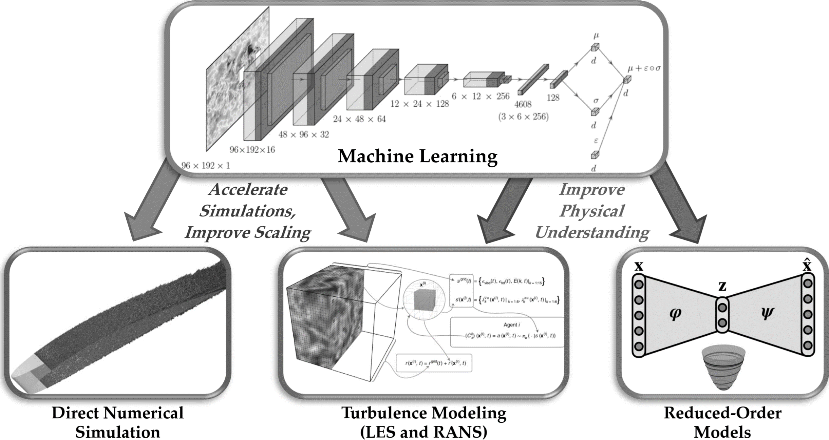
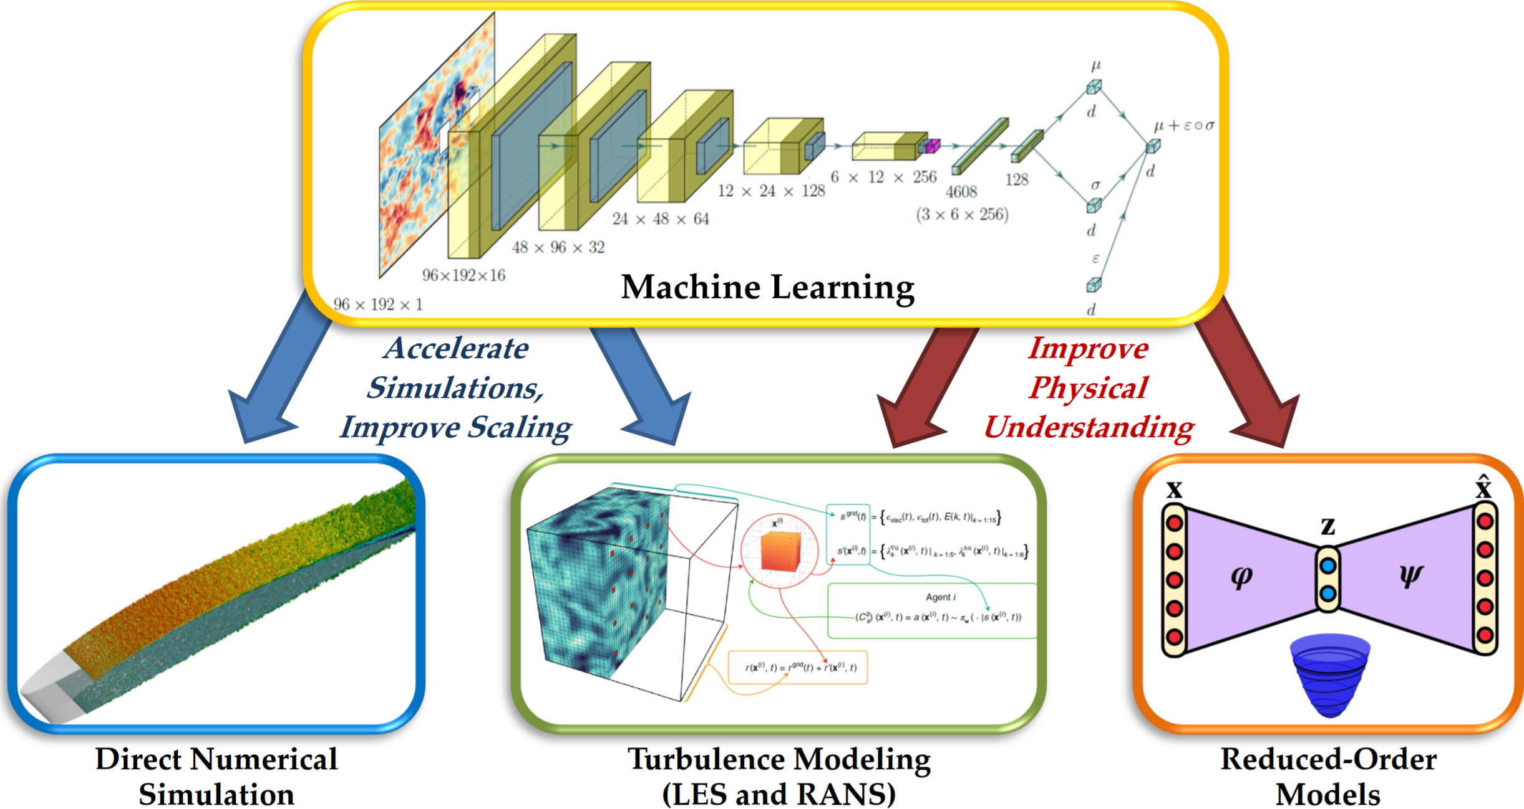
Machine learning for CFD application
※Ricardo Vinuesa and Steven L. Brunton, arXiv:2110.02085, 2021
Notes:
Pered tem kak pristupit k vypolneniyu raboty, ya provel nebolshoi research na predmet uzhe suschetsvuyuschih rabot po Machine lerning v CFD.
Suschestvuet dva osnovnyh napravleniya po primeneniyu/dobaleniyu ML v CFD:
Pervyi, nosit v pervuyu ochered akademicheskii /developerskii harakter,
eto uskorenie raschetov CFD za schet vnedreniya ML neposredstvenno v vychislitelnuyu chast CFD softa.
Naprimer pri pomoschi ML mozhno osuschetsvit tak nazyvaemyi Improve scaling, t.e. rezultaty raschetov na kruptoi raschetnoi setke “uluchshit“ do rezultatov vozmozhnyh tolko na bole melkoi setke pri nesopostavimyh vremennyh zatratah.
Tak zhe mozhno sokratit vychislitelnuyu nagruzku pri vychislenii differencialnyh uravnenii za schet predskazyvaniya nekotoryh komponentov etih uravnenii.
Osnavnaya slozhnost zdes v tom, chto, kak ya uzhe I govoril eto bolshe akademicheskaya zadacha, imeyuschaya malo otnosheniya k obychnym polzovatelyam.
Vtoroe napravlenie, k kotoromu I otnositsya moya rabota, eto umenshenie razmernosti CFD modelei.
Etot podhod primenim kogda ne stoit zadacha grubo govorya izucheniya kazhdogo otdelnogo vihrya v trehmernom prostranstve, a dostatochno poluchit usrednennoe predstavlenie o potoke.
T.e. kogda my mnogomernoe sostoyanie potok zidkosti aproksimiruem do odnomernogo, naprimer dlya polucheniya sostoyaniya v uzkom meste kanala, gde potok apriori odnomernyi, tem samym sniziv vychislitelnye zatraty.

Slide 5
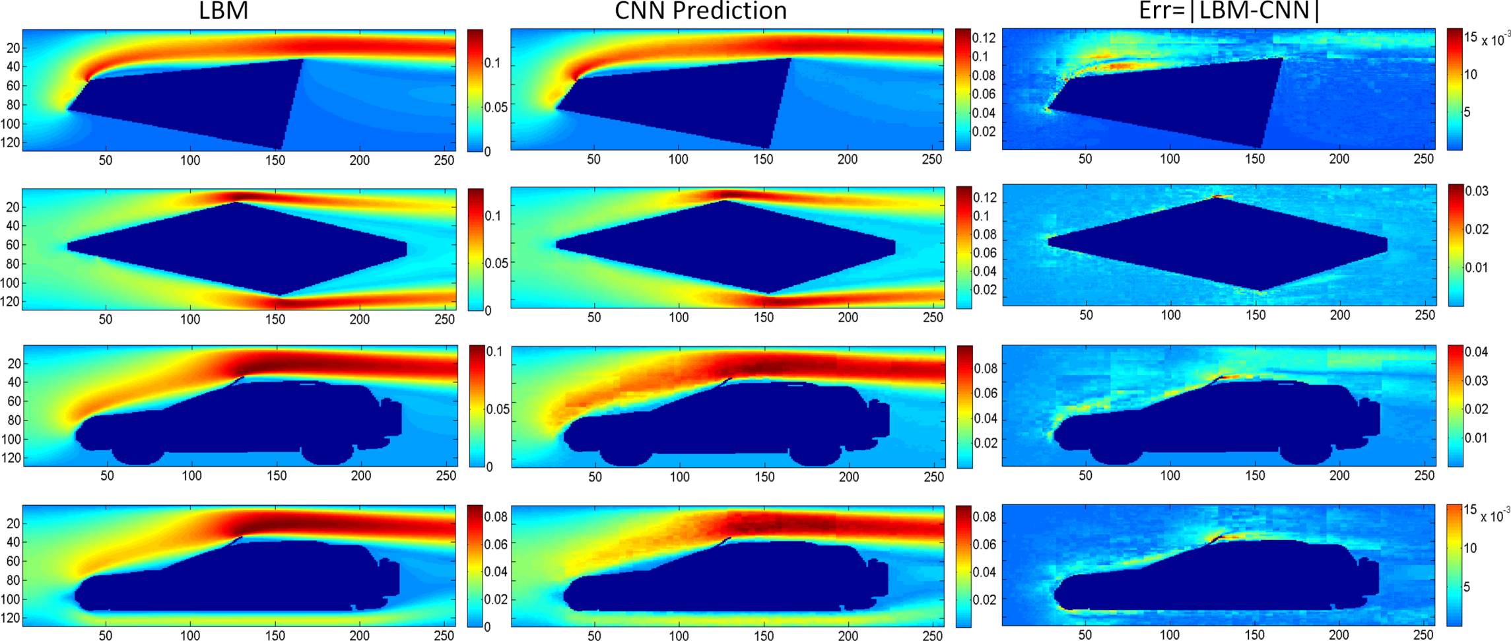
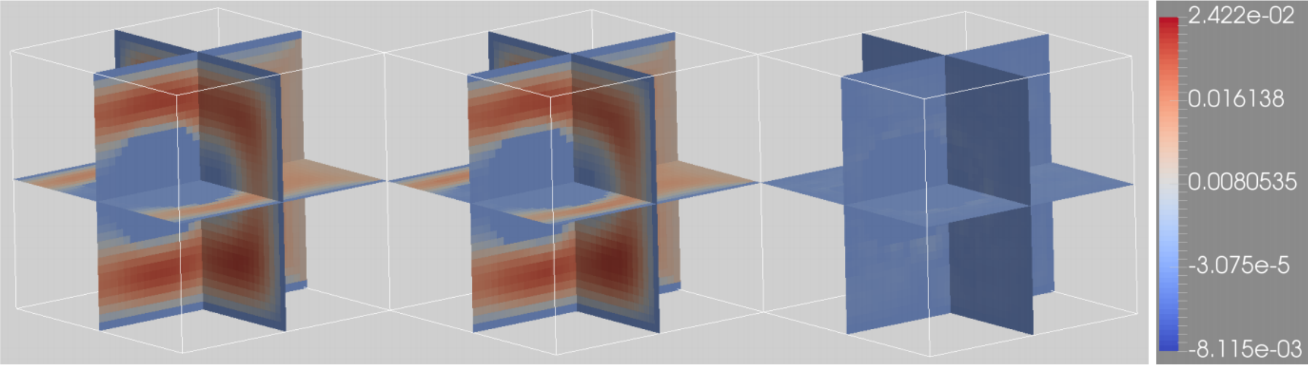
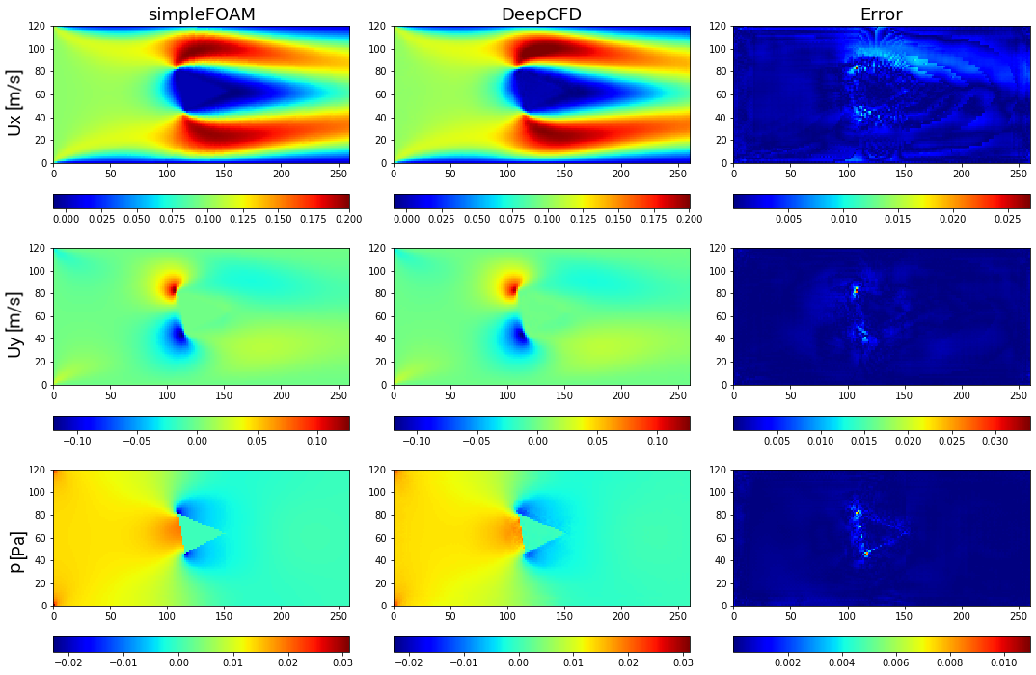
Machine learning for CFD application
Most of the reviewed projects, that have chosen way "Reduced-Order Models“, are focused on solving problem of the flow around an obstacle
The calculation field in which an obstacle is placed has a limited size
This fact imposes limitations on the applicability of projects in real work
Notes:
Pereidyom k proektam, kotorye mne udalos naiti, otnosyaschimsya ko vtromu podhodu.
Vse oni kak raz I sosredotocheny na poluchenii usrednennogo predstavleniya o potoke, naprimer pri obtekanii prepytstviya.
Est primery resheniya kak na ploskosti tak I v uslovno trehmernom prostranstave.
Odnim iz osnovnyh nedostatkov reshenii v chastnosti, I podhoda v celom, yavlyaetsya ego neuniversalnost I uzkospecializirovannost pod konkretnyi tip zadachi.
T.e. my ne imeem vozmozhnosti naprimer v dannyh rabotah izmenit raschetnuyu oblast. Pri neobhodimosti
Chut pozhe ya rasskazhu kak ya obhodil eto ogranichenie, no v nachale ya by hotel nemnogo ostanovitsya na odnom iz proektov, kotoryi byl vzyat mnoi za osnovu

Slide 6
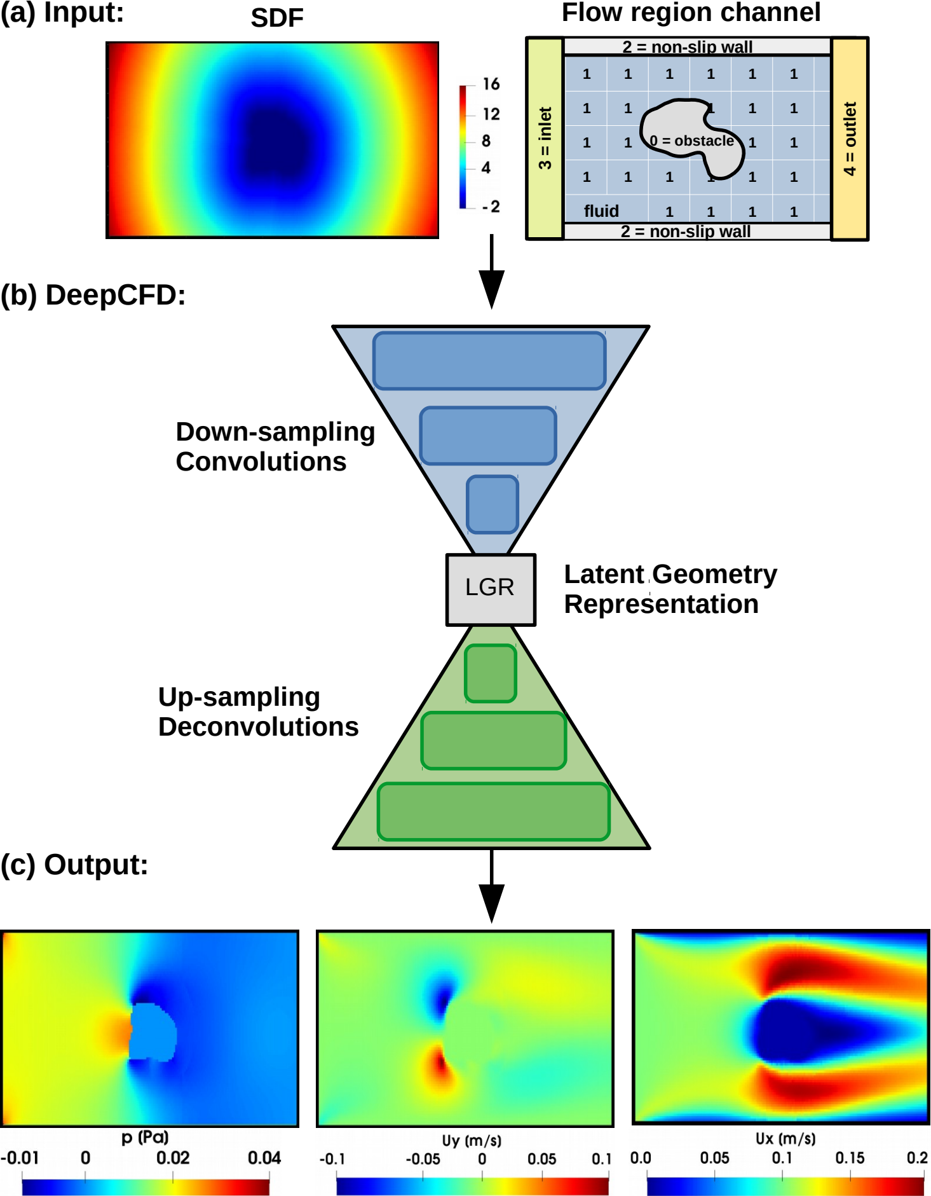
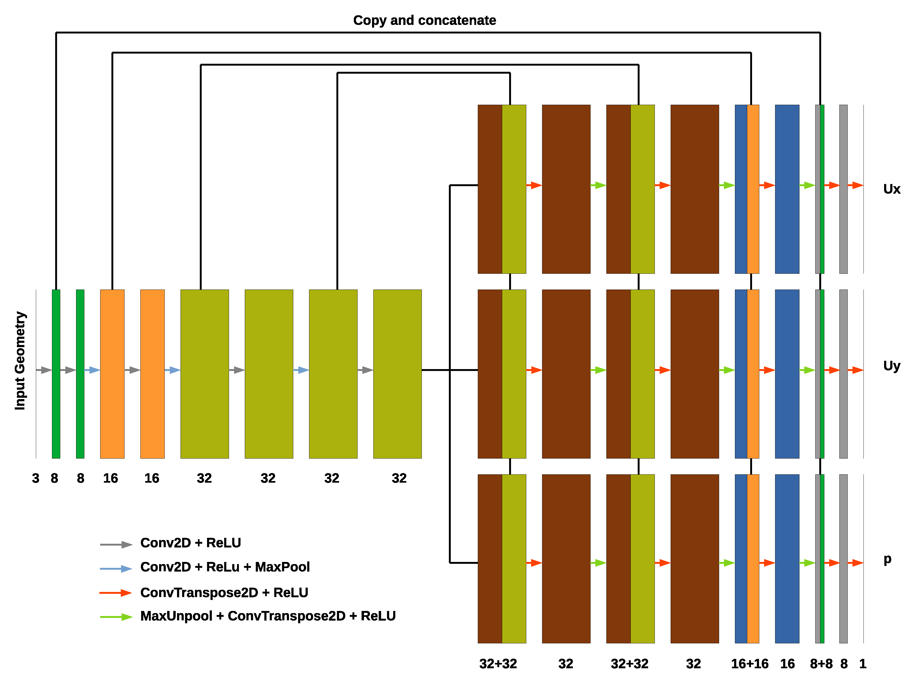

Machine learning for CFD application
Newest project with good performance is “Deep CFD”
※Mateus Dias Ribeiro at al., arXiv:2004.08826, 2020
Notes:
Odnim iz samyh novyh I pokazyvayuschii horoshii rezultat, yavlyaetsya proekt, on zhe nauchnaya rabota, pod nazvaniem DEEPCFD.
V etoi rabote avtory, obraschayut vnimanie, chto bolshistvo proektov reshayuschih zadachu obtekaniya prepyatstviya pri pomoschi konvolyucionnyh neironnyh setei osnovany na arhitekture prosteishih Autoencoder.
I pokazyvayut put k uluchsheniyu kachestva predskazanii za schet ispolzovaniya arhitektury U-net.
U-net eto arhitektura iznachalno razrabotannaya dlya zadach segmentacii na medecinskih snimkav.
Ona poluchila svoe nazvanie iz-za harakternoi formy v vide latinskoi bukvy U pri predstavlenii ee v shematicheskom vide.
V chem otlichie?
V obychnom autoencoder: vhodnoe izobrazhenie (ili ih mozhet byt neskolko) pri pomoschi konvolyucionnyh sloev I sloem MaxPoolinga szhimmaetsya do nekoego skrytogo predstavleniya,
Iz kotorogo dalee decoder pytaetsya pri pomoschi dekonvalyucionnyh I maxunpooling sloev vostanovit eto izobrazhenie. (libo zhe kakoe to drugoe zadannoe izobrazhenie) (ili ih mozhet byt neskolko)
Osnovnoi problemoi yavlyaetsya – neizbezhnaya poterya informacii pri maxunpoolinge.
V Arhitekture U-NET eta problema reshena za schet kopirovaniya chasti skrytyh sloev iz coder v decoder
Tak zhe avtory pokazali, chto v sluchae kogda vyhodnyh izobrazhenii neskolko, ispolzovanie otdelnogo decoder dlya kazhdogo iz nih, daet bolee horoshii rezultat.
Poetomu v svoei rabote za osnovu ya vzyal etot proekt.

Slide 7
Purpose
Evaluate the consistency and effectiveness of using DCNN to solve the problem, as well as the total labor and time costs (for model preparing & etc.)
Apply the knowledge and skills gained during the course and use it to solve a practical problem
Gain new knowledge by exploring a best practice (SOTA)
※DCNN – Deep Convolutional Neural Networks; SOTA – (lingo) State-of-the-art
Notes:
Cel dannoi raboty eto, Оценить состоятельность и эффективность применения glubokih konvalyucionnyh neironnyh setei k problemam gidrodinamiki, а также ocenit общие трудо- и время- затраты на podgotovku I обучение модели
Tak zhe cel etoi raboty: Применить знания и навыки, полученные в ходе курса, и использовать их для решения практической задачи

Slide 8
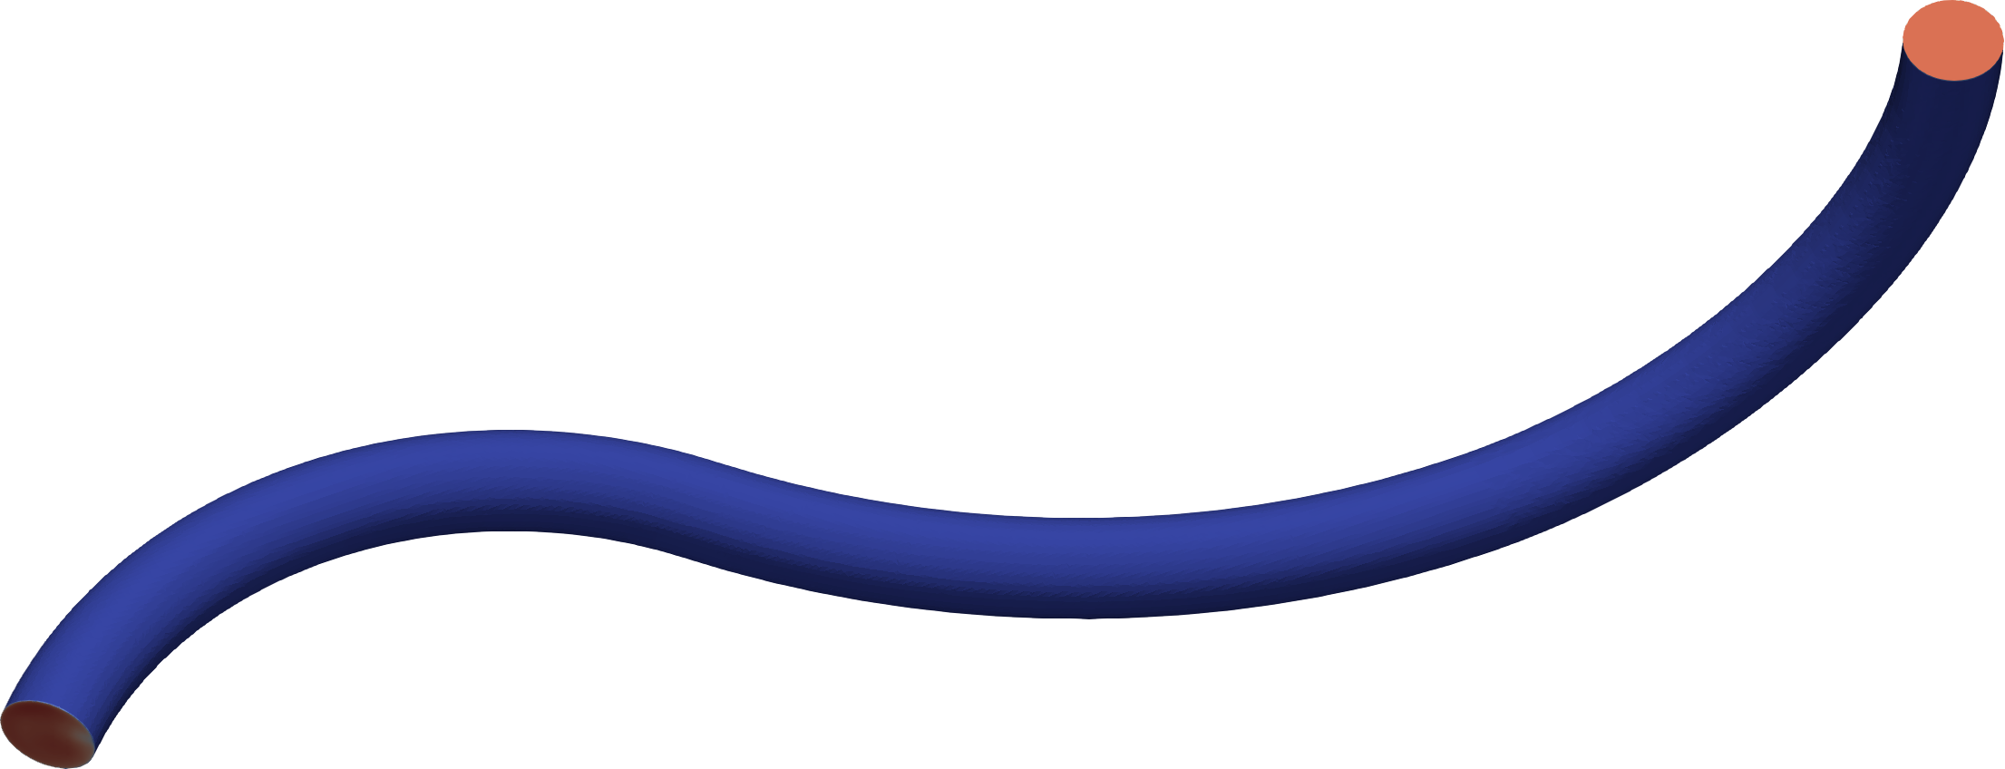
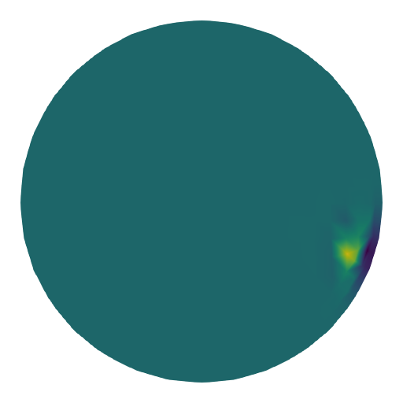
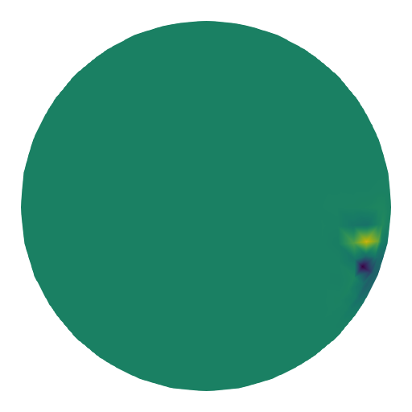


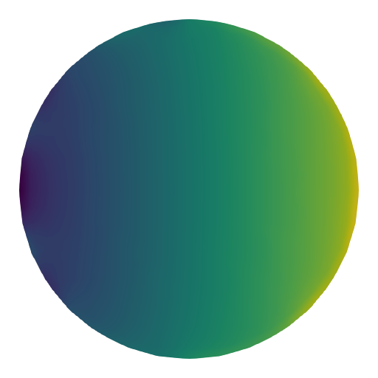
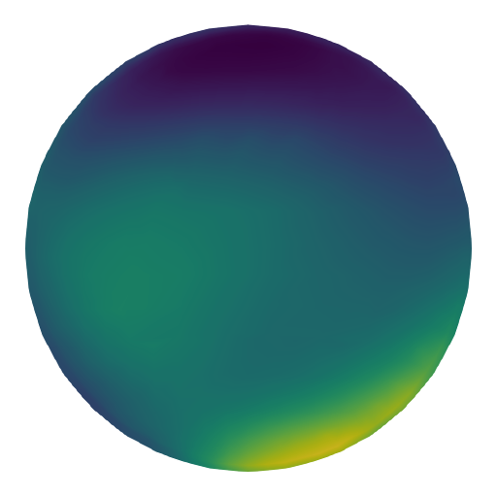
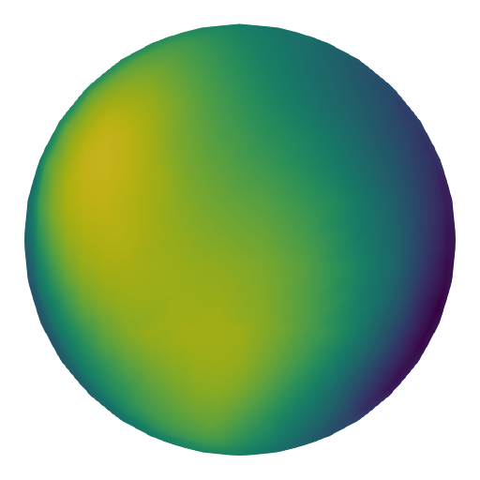
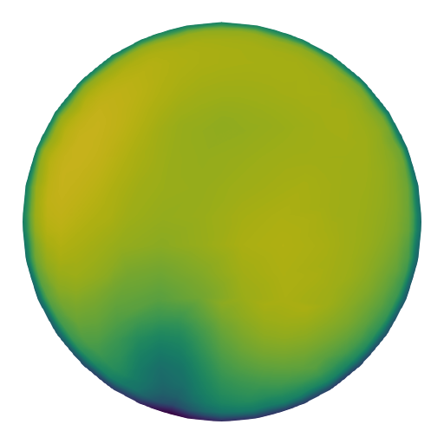
Concept: Requirements
Ability to analyze "infinitely" long pipelines of "arbitrary" shape
Ability to obtain the main characteristics of the pipeline (pressure loss and velocity) from the initial "arbitrary" flow parameters
Outlet►
Inlet
▼
Velocity components distribution fields
Pressure distribution field
Input
Ux
Uy
Uz
P
Pressure distribution field
Velocity components distribution fields
Aim
P
Ux
Uy
Uz
Notes:
Pereidem k zadacham. I chto hotelos poluchit na vyhode.
Osnovnym parametrov lyuboi gidravlicheskoi sistemy yavlyaetsya velichina poter. Izmeryaemaya v raznice davlenii na vhode I na vyhode.
Kak pravilo znachenie davleniya na vyhode nam izvestno, tak zhe nam izvestna skorost potoka na vhode.
Ispolzuya eti znacheniya,
pri pomoschi CFD my mozhem vychislit neohodimoe nam davlenie na vhode.
Odnako kak ya govoril ranee, variantov konfiguracii kakoi libo sistemy mozhet byt bolshoe kolichestvo i provedenie sootvetstvuyuschego chisla CFD raschetov mozhet zanimat mnogo vremeni.
Poetomu Hotelosby poluchit ML model sposobnuyu predskazyvat davlenie na vhode.
Odnako tak kak dlina I forma sistemy nam zaranee ne izvestna, nuzhna takaya model kotoraya budet delat predskazaniya dlya uslovno beskonechnoi I uslovno proizvolnoi formy sistemy.
Kak eto sdelat?

Slide 9
Concept: How to
Split the original geometry into sections (primitives)
Use the inlet and outlet parameters of each sections for training
Provide information to neural network on model shape (type, length, diameter, radius) of the previous, current and next sections
Initial
Pressure
Section 1
▼
Section 3►
Section 2
▼
Outlet for Section 1
Inlet fro Section 2
Outlet for Section 2
Inlet fro Section 3
Initial
Velocity components
Original model
(1 initial set)
Shape info
Section 1
Set for training
Section 2
Set for training
Section 2
Set for training
Notes:
Moya ideya zaklyuchaetsya v tom, chtoby obuchit model delat predskazaniya ne dlya vsei sistemy razom, a posektoralno.
T.e. my mozhem podelit vsyu sistemu na primitivy, takie kak naprimer pryamoi uchastok ili uchastok s povorotom na nekii ugol.
I tem samym, vopervyh, my poluchim bolshe dannyh dlya obucheniya modeli pri menshih vremennyh zatratah na CFD raschety.
T.k. nam stanovyatsya ne nuzhny rezultaty CFD raschetov dlya ochen dlinnyh system. (v dannoi rabote ya oboshelsya sistemami maksimalnoi dliny v tri sekcii)
Pravda zabegaya nemnogo vpered etogo okazalos nedostatochno dlya kachestvennyh predskazanii.
Vovtoryh, sobstvenno, po itogu, poluchim vozmozhnost delat inference dlya system lyuboi dliny I formy.
Nu I vtretih u nas poyavitsya vozmozhnost dat modeli znat konfiguraciyu samoi sistemy.
T.k. zadat razom konfiguraciyu vsei sistemy dovolno tyazhelo I izlishne v kakoto stepeni. Chem zadat konfiguraciyu tolko dlya tekuschei sekcii I predyduschei I sleduyuschei sekcii.

Slide 10
Workflow: Data generation
CAD model Generation
CFD Pre-processing
CFD Solving
CFD Post-processing
CadQuery
Python script
FreeCAD
Add-on: CfdOF
Python script (Macros)
OpenFOAM
SimpleFOAM solver
Bash-scripts
ParaView
Python script (Macros)
Totally 2058 models
About 200 row of code
Runtime 3 min 15 sec
About 300 row of code
Runtime about 24 hrs
2 bash-scripts to automate the process
Runtime about 1 week on 2 workstations
About 250 row of code
Runtime about 12 hrs
Totally 6024 input sets (15 files was broken)
Including max and min values of each cross section
CadQuery : https://github.com/CadQuery/cadquery
FreeCAD : https://www.freecadweb.org/
CfdOF add-on : https://github.com/jaheyns/CfdOF
OpenFOAM : https://www.openfoam.com/
ParaView : https://www.paraview.org/
Notes:
Raskazhu nemnogo o tom skolko vremeni zanimaet realnyi CFD raschet.
Dlya dannoi raboty ya sgeneriroval okolo 2000 variantov system raznyh dlin I form.
I tolko na podgotovku CFD modelei ushlo okolo 24 chasov. A sam raschet vsego etogo zanyal okolo nedeli pri tom chto raschet osuchestvlyalsya na dvuh mashinah.
Nu I po itogu poluchilos podgotovit nabory obuchayuschih dannyh dlya okolo 6000 sektorov.

Slide 11
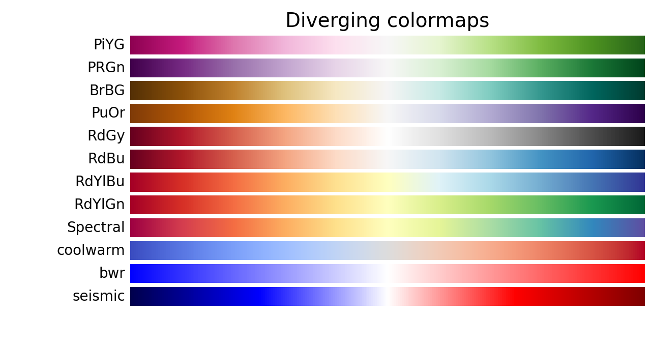
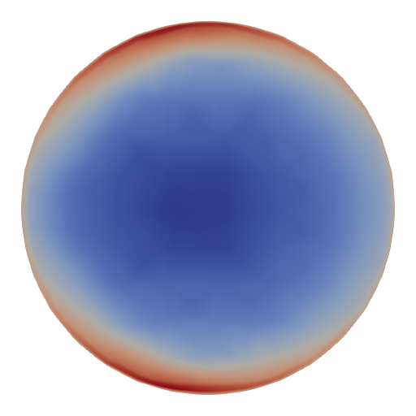
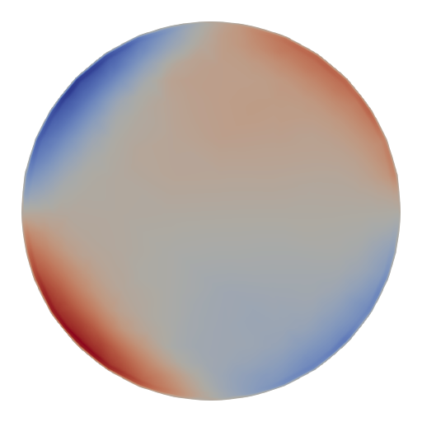
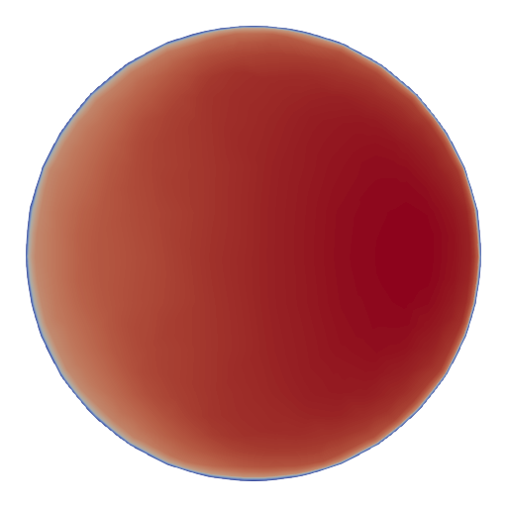
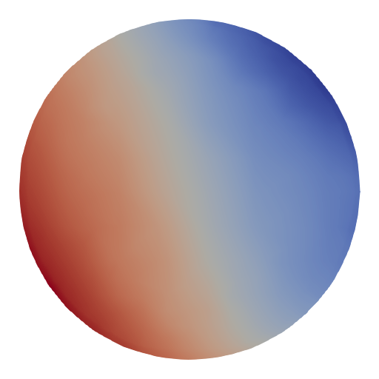
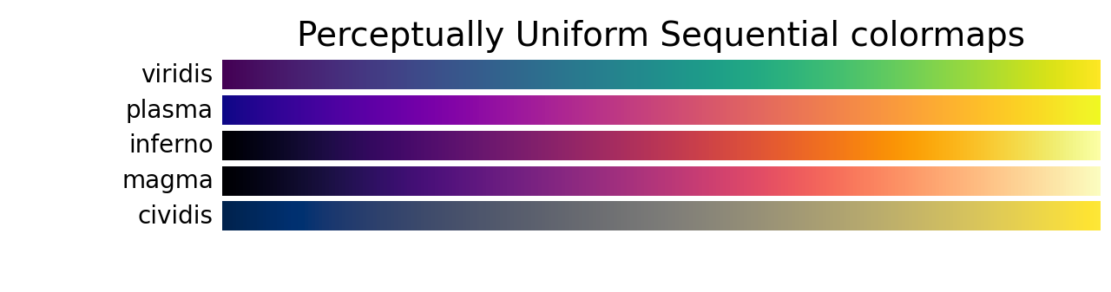
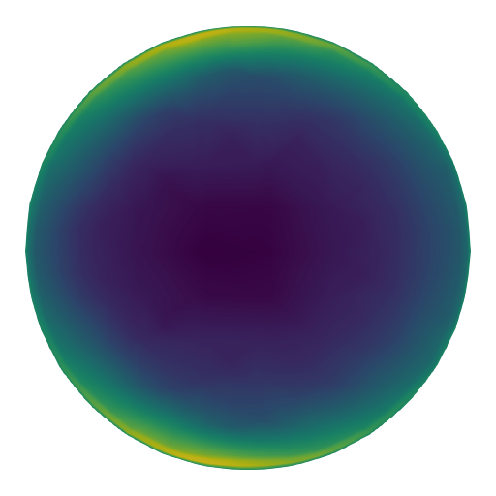
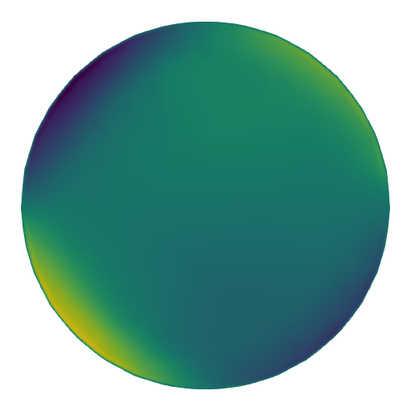
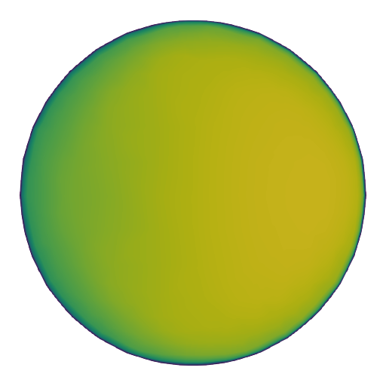

Workflow: Data generation
Diverging
For the Diverging maps, we want to have monotonically increasing L* values up to a maximum, which should be close to L*=100, followed by monotonically decreasing L* values. We are looking for approximately equal minimum L* values at opposite ends of the colormap. By these measures, BrBG and RdBu are good options. coolwarm is a good option, but it doesn't span a wide range of L* values (see grayscale section below).
Sequential
For the Sequential plots, the lightness value increases monotonically through the colormaps. This is good. Some of the L* values in the colormaps span from 0 to 100 (binary and the other grayscale), and others start around L*=20. Those that have a smaller range of L* will accordingly have a smaller perceptual range. Note also that the L* function varies amongst the colormaps: some are approximately linear in L* and others are more curved.
Notes:
Zdes hotelos by sdelat nebolshoe liricheskoe otstuplenie. Dlya the kto kak I ya nikogda ne zadumyvalsya o tom kak ustroeny cvetovye gradient.
Iznachalno ya ne pridal znacheniya tomu, chto v softe dlya post obrabotki CFD raschetov po umolchaniyu ispolzuetsya Diveging colormaps, tak kak schital chto lyuboi colormaps mozhno pereschitat v lyuboi drugoi.
Odnako eto okazalos ne tak. V diverging colormapsah rasstoyaniya ot uslovnogo nulya do cvetov oboznachayuschih maksimalnoe I minimalnoe znacheniya odinakovo, I pri popytke konvertirovat mnogo kanalnoe, v dannom sluchae RGB, izobrazhenie v odnokanalnoe
Voznikala problema chto v grayscale izobrazheniyah maksimalnoe I minimalnoe znacheniya byli nerazlichimy.
Poetomu prishlos potratit esche odin den dlya izvlechniya dannyh iz rezultatov CFD raschetov v pravilnom uniform sequential colormaps.

Slide 12
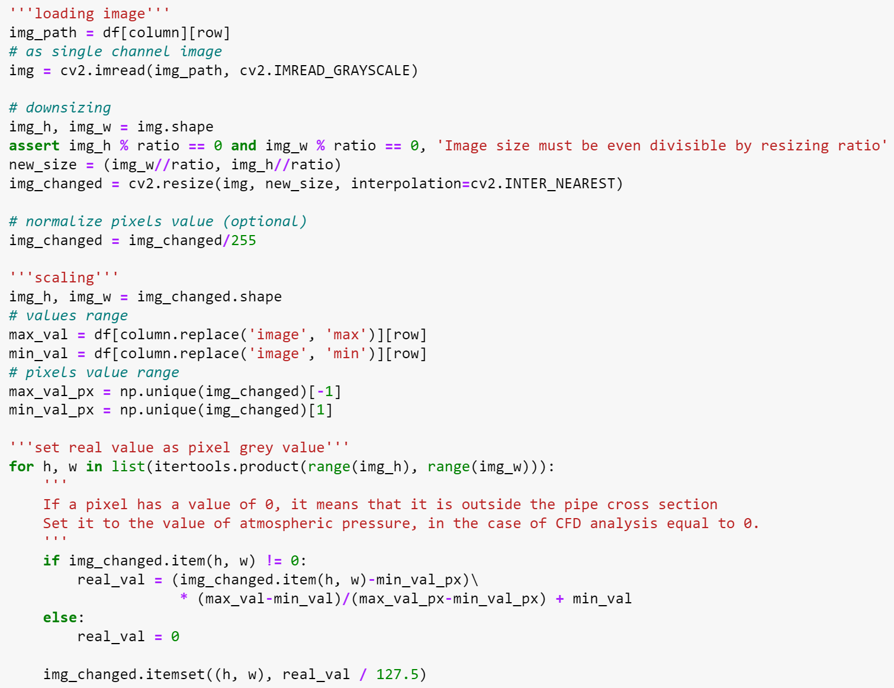
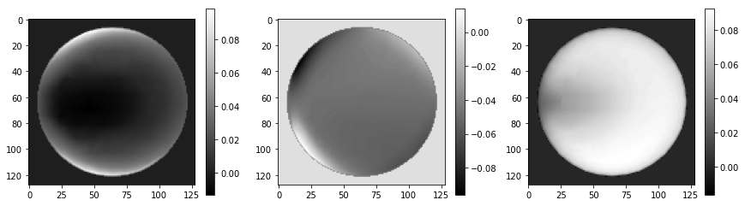
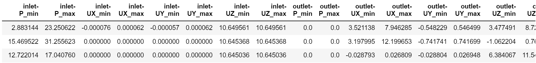
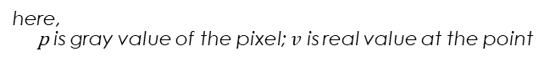
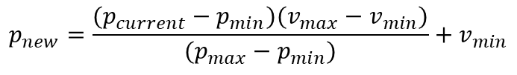
Workflow: Data generation
Data conversion to a single channel grayscale image
Pixel value normalization ([-1:1])
Changing color value to real value
①
②
$$p_{new}=\frac{(p_{current}−p_{min})(v_{max}−v_{min})}{(p_{max}−p_{min})}+v_{min}$$
here, p is gray value of the pixel; $v$ is real value at the point
③
Notes:
Dalee nemnogo tehnicheskoi informacii po predopbarbotke dannyh.
Pervym shagom bylo, kak ya I govoril, konvertirovanie RGB izobrazheniya v odnokanalnyi grayscale format.
Dlya togo chtoby snizit vychislitelnuyu nagruzku pri obuchenii modeli.
Vtoroi, eto standartnyi shag dlya vseh convalyucionnyh modelei – normalizaciya zanchenii.
I poslednee, tak kak u raznyh modelei znacheniya maksimalnogo I minimalnogo, naprimer, davleniya razlichayutsya, a cveta otvechayuschie za eti znacheniya net.
To prishlos sdelat normalizaciyu/ ili masshtabirovanie po vsem datasete. T.e. ya zamenil abstraktnye znachenya svetimosti pikselya, na realnoe znachenie, naprimer, davleniya iz sootvetstvuyuschei emu tochki prostranstava.

Slide 13
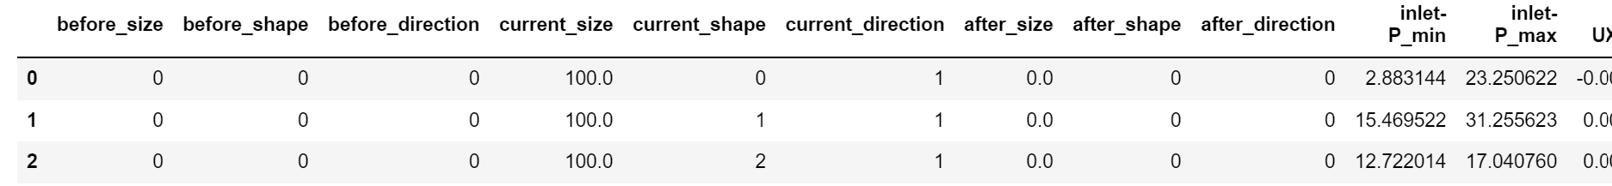
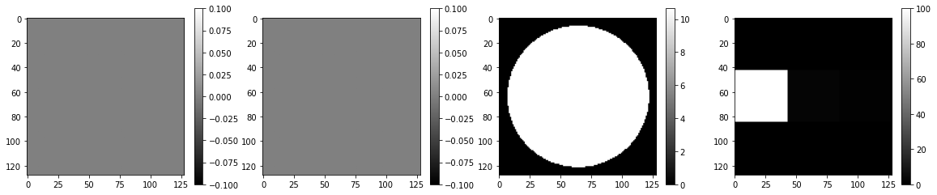
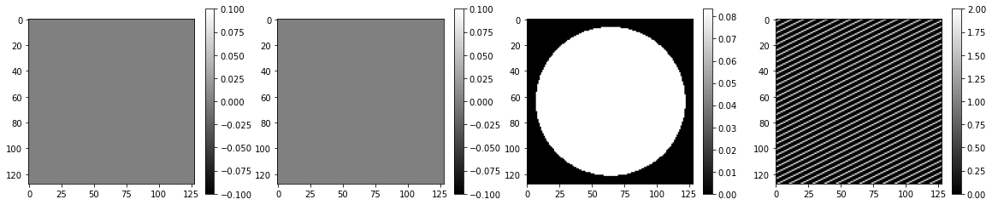
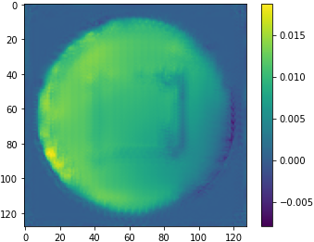
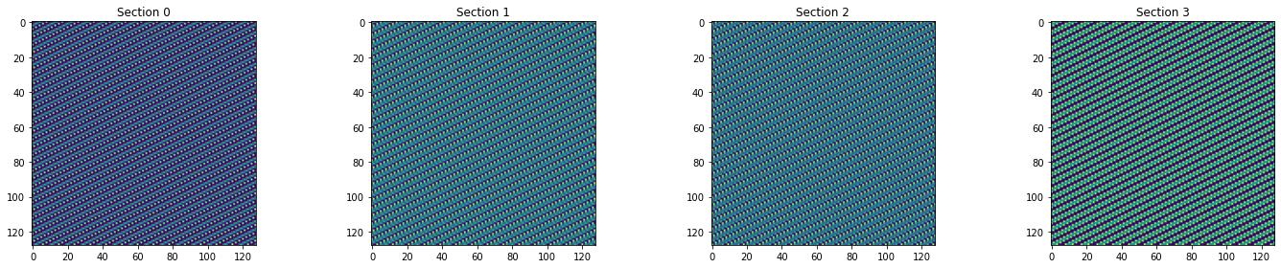
Workflow: Data generation
Label encoding of “*size” column
Using Tessellation instead Tile
0 | 0 | 0 | 1 | 2 | 1 | 0 | 0 | 0
0 | 0 | 0 | 1 | 2
1 | 0 | 0 | 0
0 | 0 | 0 | 1 | 1 | 2 | 1 | 0 | 1
Notes:
Teper o tom kak podavalis v model dannye o forme sektorov.
Po primeru iz ishodnogo proekta opisanie geometrii dolzhno predstavlyat iz sebya massiv togo zhe razmera chto I izobrazheniya.
S toi lish raznicei chto v moem sluche opisanie geometrii zanimaet vsego 9 znachenii.
I nuzhno bylo pridumat kak ih optimalno razmestit v massive.
Iznachalno ya dumal sdelat nekoe podobie QR koda, podeliv massiv na ravnye plitki kazhdaya iz kotoryh opizyvalo odim parameter.
Odnako pri pervom zhe progone vyyasnilos chto, eto ne sovsem udachnaya ideya.
Modeli tyazhelo ulovit takie bolshie struktury.
Chto privodilo k vozniknoveniyu takogo roda artifaktov.
Poetomu ya zamenil plitochnuyu fromu na zalivku. I uzhe takie pattern horosho vosprinyalis modelyu.

Slide 14
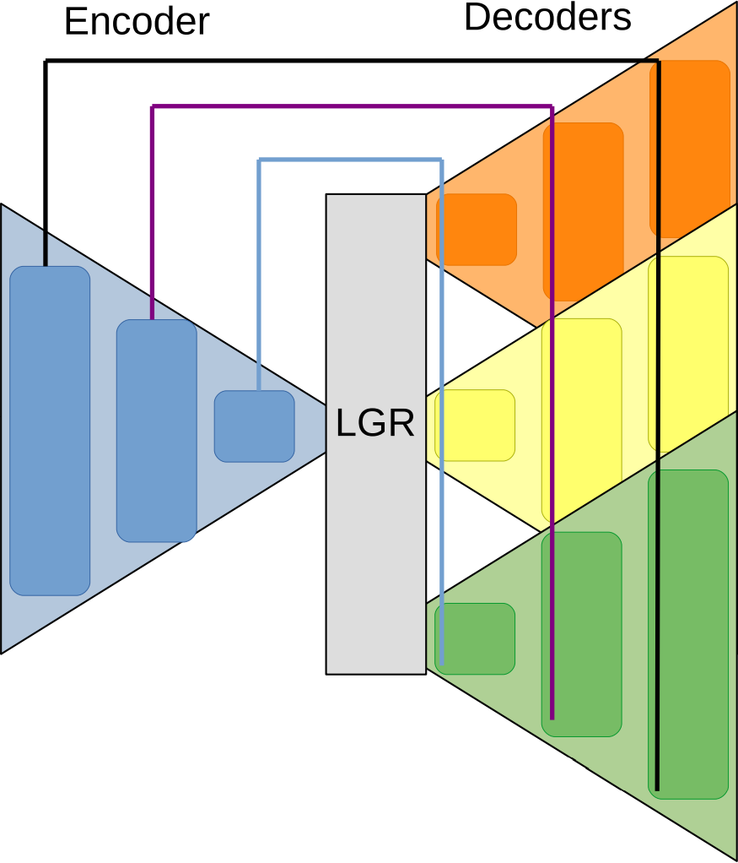
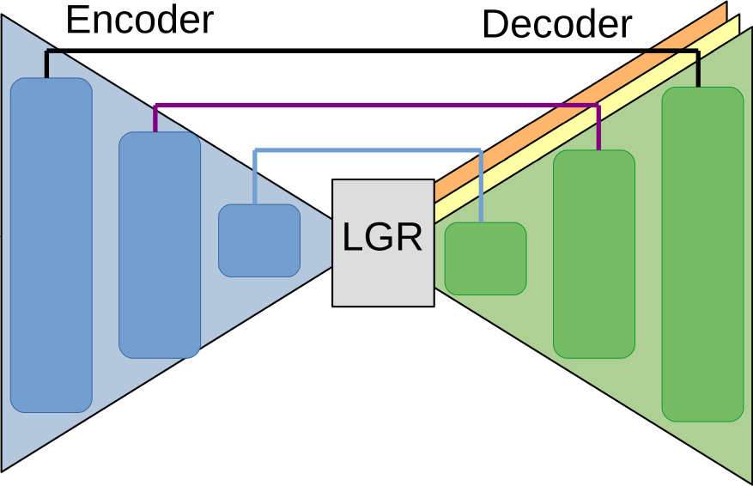
Workflow: DCNN Model
Model V: Velocity to Velocity
Outlet►
Ux
Ux
Uy
Inlet
▼
Uy
Uz
Uz
G
Velocity components distribution fields
Pressure distribution field
Model P: Pressure+Velocity to Pressure
Initial
Ux
Ux
Uy
Uz
P
Uy
Pressure distribution field
Velocity components distribution fields
P
Uz
Want to get
Uz
P
P
Ux
Uy
Notes:
Dalee o tom kakie neironnye seti obuchalis.
Chtoby osuschetvit zadumannyi inference (o kotorom nemnogo pozzhe), neobhodimo bylo obuchit srazu dve modeli.
Pervaya iz kotoryh preobrazuet znacheniya skorostei na vhode v sektor v znacheniya skorostei na vyhode iz sektora.
Plus k vhodnym kanalam byl dobalen kanal s opisaniem geometrii.
A na za kazhdyi kanal na vyhode otvechal svoi otdelnyi dekoter.
Vtoraya model poprosche, ona po izvestnomu znacheniyu davleniya na vyhode I predskazannym znacheniyam na vhode sektora predskazyvaet iskomoe nam davlenie na vhode.

Slide 15
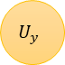
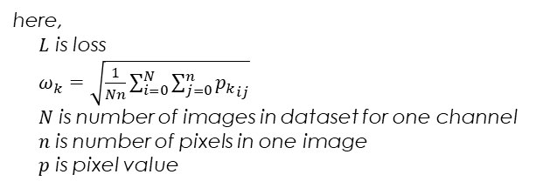
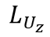
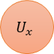
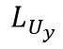
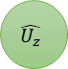
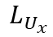
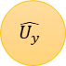
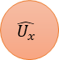
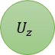
Workflow: Loss function
Ux
$$\hat{U_{x}}$$
$$U_{x}$$
$$L_{U_{x}}$$
Uy
$$\hat{U_{y}}$$
$$U_{y}$$
$$L_{U_{y}}$$
Uz
$$\hat{U_{z}}$$
$$U_{z}$$
$$L_{U_{z}}$$
G
$$L_{total}=ω_{U_{x}}L_{U_{x}}+ω_{U_{y}}L_{U_{y}}+ω_{U_{z}}L_{U_{z}}$$
here,
$L$ is loss
$ω_{k}=\sqrt{\frac{1}{Nn}\sum_{i=0}^{N}{\sum_{j=0}^{n}{{p_{k}}_{ij}}}}$ $N$ is number of images in dataset for one channel
$n$ is number of pixels in one image
$p$ is pixel value
Notes:
Vskolz upomyanu o ispolzuemoi funkcii poter,
Tak kak v pervoi modeli na vyhode u nas tri kanala so svoim dekoderom, dlya obucheniya encodera nuzhen total loss.
Avtory ishodnogo proekta predlagayut ispolzovat vzveshennuyu summu
Odnako v moem sluchae etot podhod okazalsya huzhe chem prosto summa lossov.

Slide 16
Workflow: Inference
Initial
P
Predicted
Ux, Uy, Uz
Section 1
▼
Predicted
P
Section 2
▼
Predicted
P
◄Section 3
Predicted
P
Predicted
Ux, Uy, Uz
Predicted
Ux, Uy, Uz
Initial
Ux, Uy, Uz
Initial
Ux, Uy, Uz
Model V
Predict 1:
Ux, Uy, Uz
Model V
Predict 2:
Ux, Uy, Uz
Predict N-1:
Ux, Uy, Uz
Model V
Predict N:
Ux, Uy, Uz
Section 1
Section 2
Section N
Predict N:
P
Model P
Predict N-1:
P
Model P
Predict N-2:
P
Predict 1:
P
Model P
Initial
P
Notes:
I v zaklyuchenii rasskazhu ob inference.
Na pervom shage imeya zadannye znacheniya skorostei na vhode pri pomoschi pervoi neiroseti predskazyvaem znacheniya na vyhode,
Dalee ispolzuya eti predskazannye znacheniya kak vhod v sleduyuschuyu sekciyu povtoryaem operaciyu. Do togo poka ne doidem do poslednei sekcii.
Posle etogo uzhe ispolzuya zadannoe znachenie davleniya na vyhode I predskazannye zancheniya skorostei na vhode pri pomoschi vtoroi neiroseti
Delaem seriyu predskazanii poka nedoidem do pervoi sekcii.

Slide 17
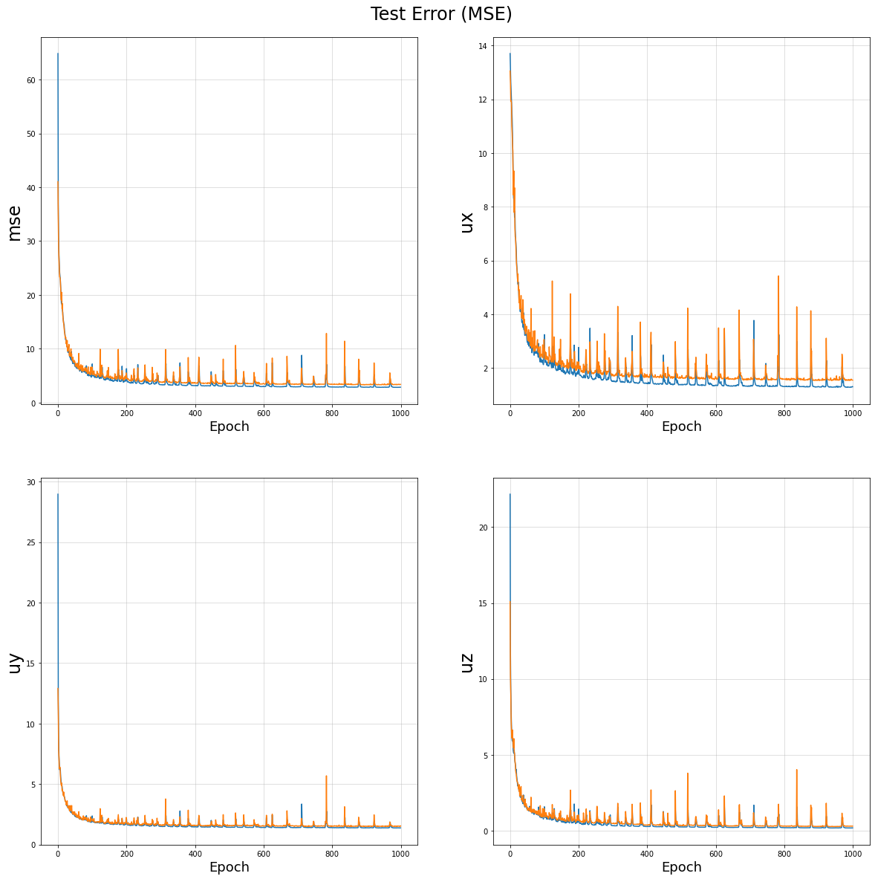
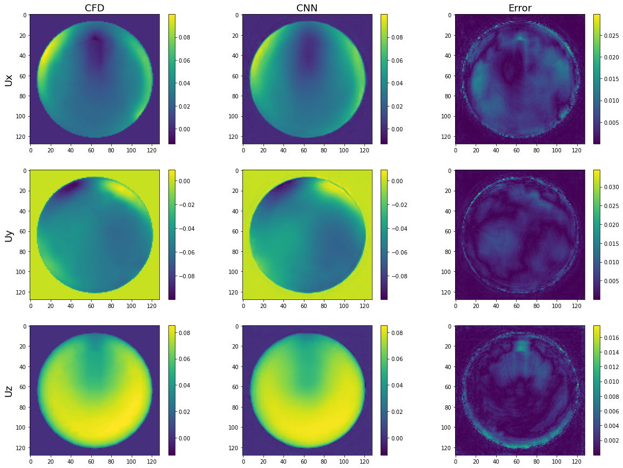
Results: Validation
z
x
z
y
y
x
x
y
z
Notes:
O rezultatah
V celom pervaya model obuchaetsya dostatochno bistro, 1000 epoh eto s bolshim zapazom
Rezultaty predskazaniya, v kachetvennom plane dostatochno horoshie, chto nelzya skazat kolichestvennom
T.e. raznica v znacheniyah dovolna vysokaya, osobenno po krayam
Cho vprincype ne ploho soglasuetsya s rezultatami ishodnogo proekta.

Slide 18
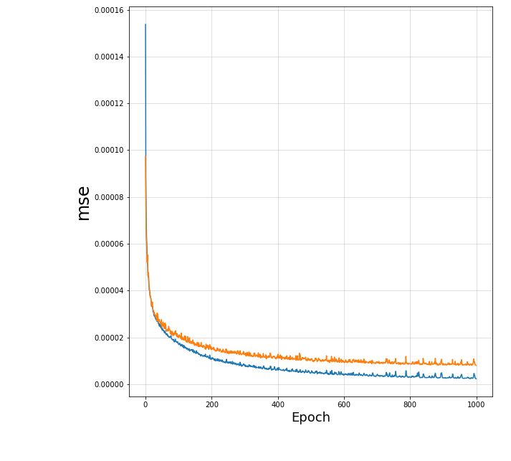
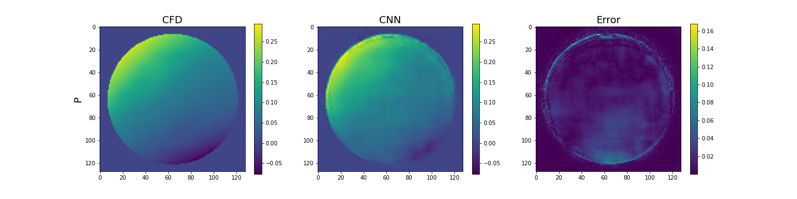
Results: Validation
z
x
z
y
y
x
x
y
z
Notes:
Po vtoroi modeli mozhno sdelat pohozie vyvoy s toi lish raznicei chto 1000 epoh okazalos nedostatochno I model nedoobuchena.

Slide 19





Results: Inference
Notes:
Na inference, k sozhaleniyu, okazalos ne vse tak horosho. Rezultat oakazlsya dalek ot moih ozhidanii.
Model inferensa imeet takuyu zamyslovatuyu vormu
Uzhe na pervoi sekcii rezultat predskazaniya dalek ot istiny.
Eto mozhet byt vyzvano:
Vozmozhno neobhodima post obrabotka rezultatov, chtoby udalit oshibochnye rezultaty vne zony interesa
Nedostatochno dannyh dlya obucheniya, ya ogranichelsya modelyami ot odnoi sekcii do 3
Podpor giper parametrov byl vypolnen ne v polnom obyome. T.e. nuzhen bole moschnyi kompyuter chem u menya. Obuchneie odnoi modeli v srednem zanimal 9-12 chasov.
Neudachnaya ideya inference, tak kak oshibka nakaplivaetsya

Slide 20
Summary

